Slide 1



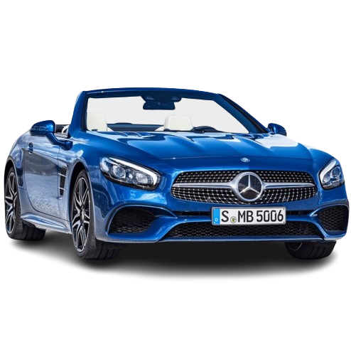
FSD PROJECT
Title
Introduction
Functionalities
Problem Solved
Future Scope
Car Sales
AUTOMOBILE WEBSITE
By Chirag patel
Computer Engineering
A3,94
22002170110107

Slide 2
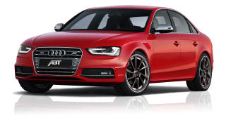
Title
Introduction
Functionalities
Problem Solved
Future Scope
With Python interface –Tkinter (GUI)
Automobile Website With All Luxurious Brand

Slide 3
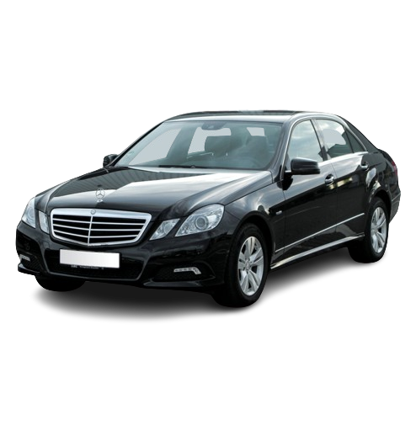
Title
Introduction
Functionalities
Problem Solved
Future Scope
Sign Up
Login
All Luxurious Brand
Cars Specifications
Book A Test Drive

Slide 4

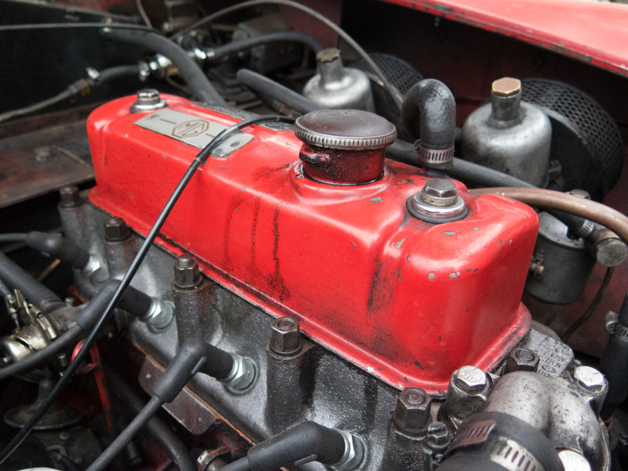
Problem Solved
Future Scope
Title
Future Scope
Title
Introduction
Introduction
Functionalities
Functionalities
Surfing Same Websites
Virtual Showrooms
Price Comparison
Rumoring Around For Test Drives

Slide 5

Problem Solved
Future Scope
Title
Future Scope
Title
Introduction
Introduction
Functionalities
Functionalities
Decoding With Bugs
Hassle Free
Integrating With Django
Displaying data for more cars dynamically, not just limited to 30-40 cars.
Making Interface For Comparison Between Two Or More Cars

Slide 6
ANY QUESTIONS ?

Slide 7
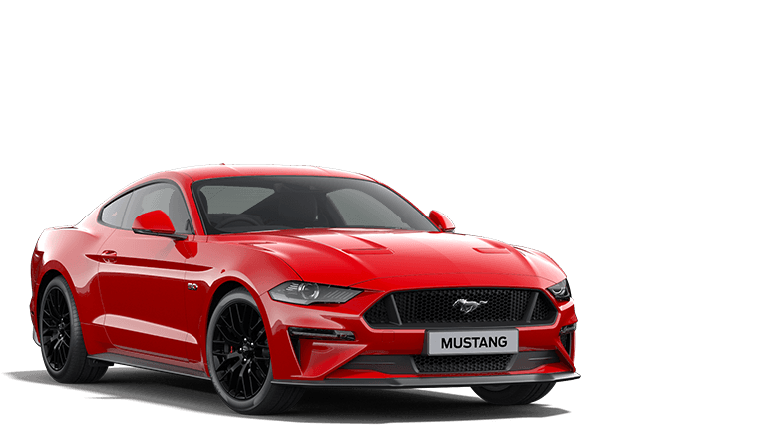
Thank You!

